Slide 1
Dynamic Programming
Knapsack Problem
SSP1 Group 1

Slide 2
Bounded Knapsack vs Unbounded Knapsack
Knapsack problem refers to the problem of optimally filling a bag of a given capacity with objects which have individual size and benefit. The objective is the increase the benefit while respecting the bag's capacity.
In the original knapsack problem, the number of items are limited and once it is used, it cannot be reused. This restriction is removed in Example Class 3: Unbounded Knapsack Problem where it is mentioned that there are unlimited supplies of each type of objects. In this case, an item can be used infinite times. This problem can be solved efficiently using Dynamic Programming.

Slide 3
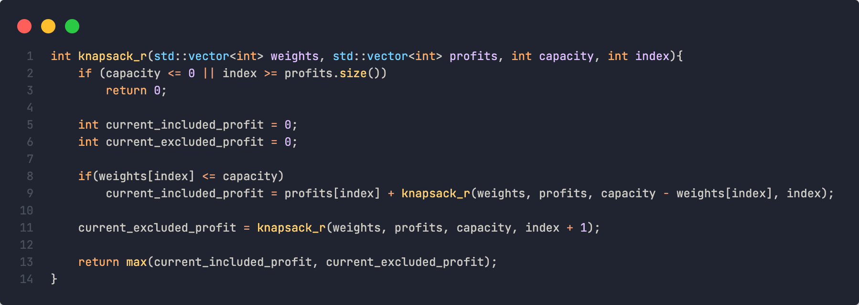
Knapsack Recursion Function P(C)
Recursive Solution using Brute Force Approach
Try all possible combination of given items and choose the one with maximum profits.
The only difference from 0/1 knapsack is after including the item we recursively call to process all items (instead of remaining).

Slide 4
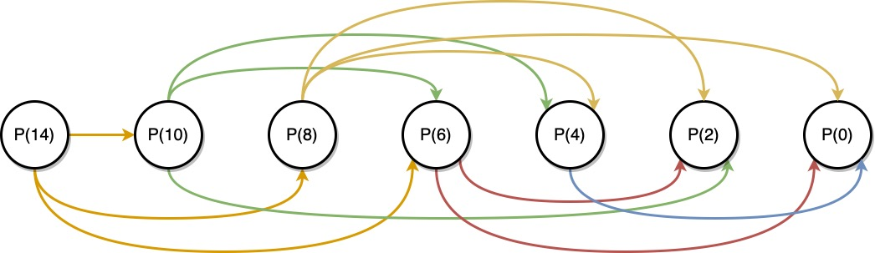
Subproblem Graph

Slide 5
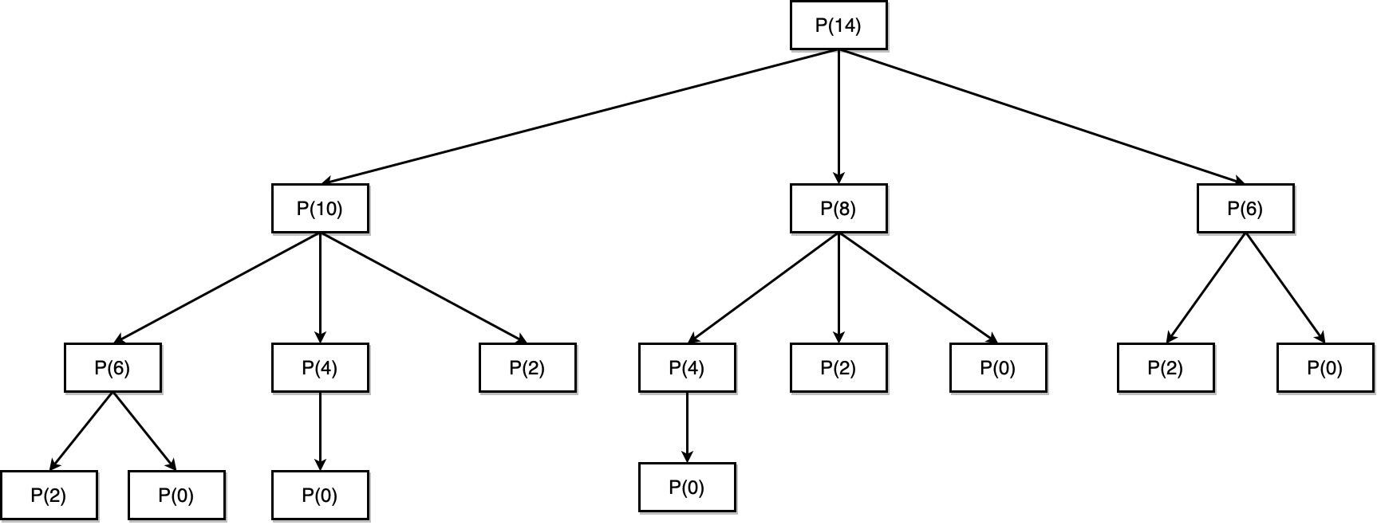
Subproblem Graph

Slide 6
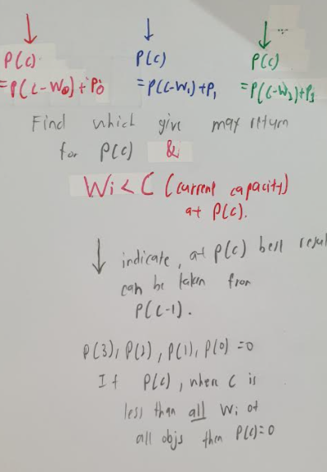
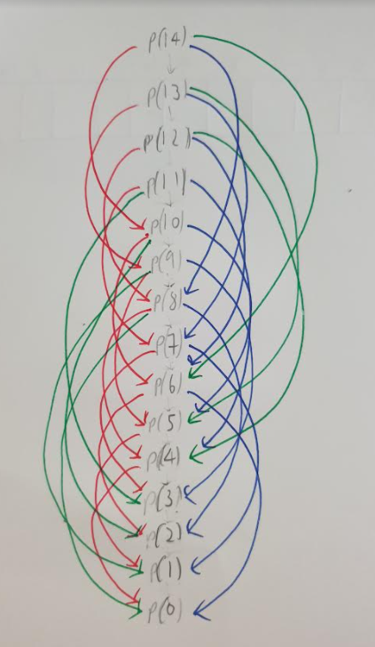
Sub Problem Graph of P(14) when n is 3
P(c) = P(c - Wi) + pi,
Where i is 0,1,2
representing obj 1,2,3 respectively.
Red imply obj1 chosen
Blue imply obj2 chosen
Green imply obj3 chosen
Find which object chosen at current capacity will give max return for P(c)
If(Wi < c,(the current capacity ar P(c))
P(c) will be 0.
From the graph P(3) to P(0), c is less then all Wi of all objs thus P(c) = 0 for c<=;

Slide 7
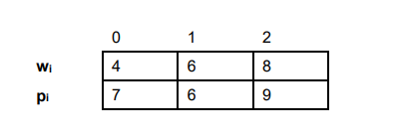
Sub Problem Graph of P(14) when n is 3
Part 1a
P(c) = P(c - Wi) + pi,
Where i is 0,1,2
representing obj 1,2,3 respectively.
Red imply obj1 chosen
Blue imply obj2 chosen
Green imply obj3 chosen
Find which object chosen at current capacity will give max return for P(c)
If(Wi < c,(the current capacity ar P(c))
P(c) will be 0.
From the graph P(3) to P(0), c is less then all Wi of all objs thus P(c) = 0 for c<=3.

Slide 8
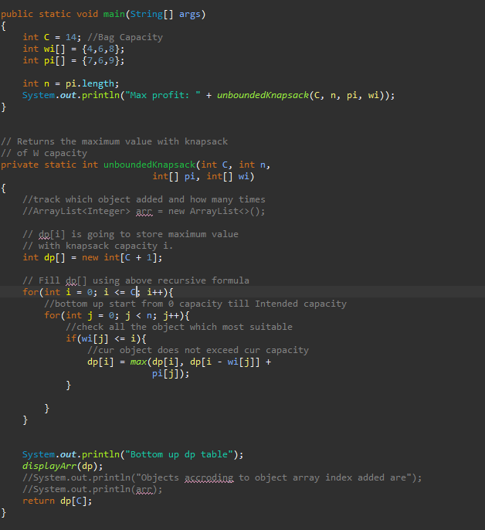

Part 1a
Dp[c] will be int array of size 15 to 14 to hold capacity from 0 to 14;
Start from when c = 0 till c = 14
If(all obj weight less than current capacity c)
then dp[i] = 0;
Else{
Check all objs and see if their weight suitable for current capacity
dp[i] will be updated if there is a better profit ar current capacity level
}
Time complexity
O(CN)
C - capacity
N - number of objc

Slide 9
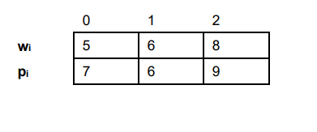
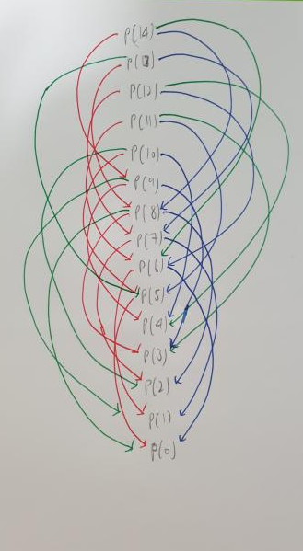
Sub Problem Graph of P(14) when n is 3
Part 1b
P(c) = P(c - Wi) + pi,
Where i is 0,1,2
representing obj 1,2,3 respectively.
Red imply obj1 chosen
Blue imply obj2 chosen
Green imply obj3 chosen
Find which object chosen at current capacity will give max return for P(c)
If(Wi < c,(the current capacity ar P(c))
P(c) will be 0.
From the graph P(4) to P(0), c is less then all Wi of all objs thus P(c) = 0 for c <= 4;

Slide 10
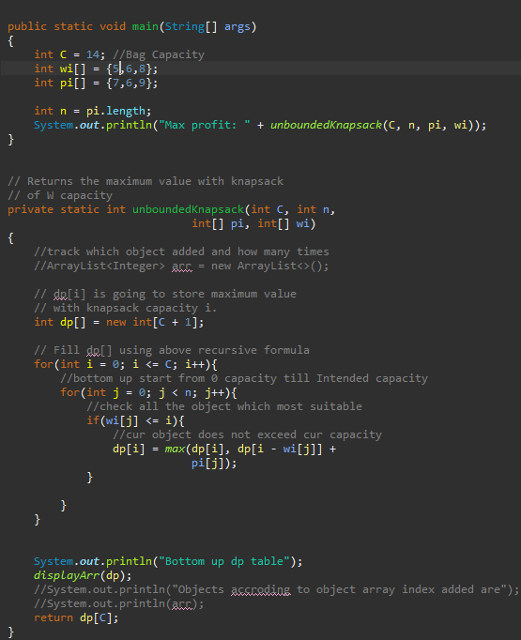

Part 1b
Dp[c] will be int array of size 15 to 14 to hold capacity from 0 to 14;
Start from when c = 0 till c = 14
If(all obj weight less than current capacity c)
then dp[i] = 0;
Else{
Check all objs and see if their weight suitable for current capacity
dp[i] will be updated if there is a better profit ar current capacity level
}
Time complexity
O(CN)
C - capacity
N - number of objc

Slide 11
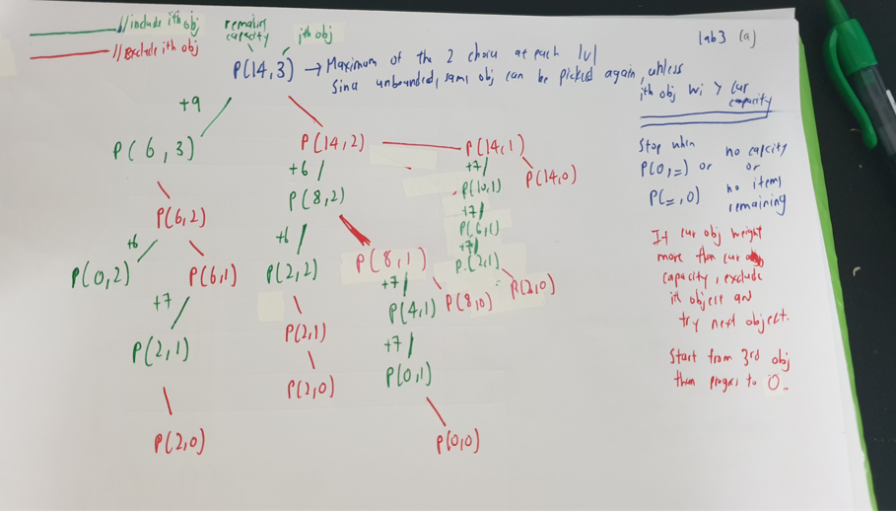
Recursive tree for part 1a

Slide 12
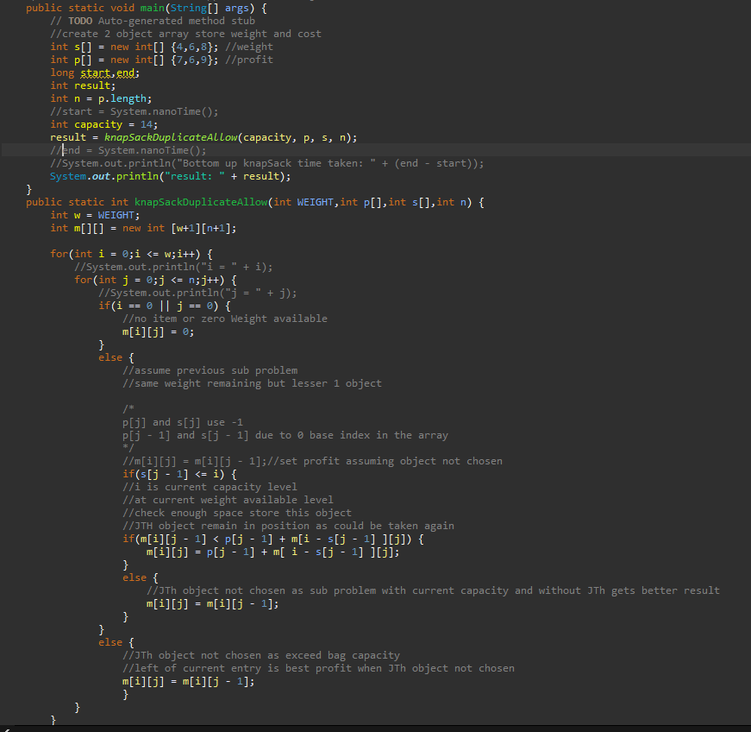
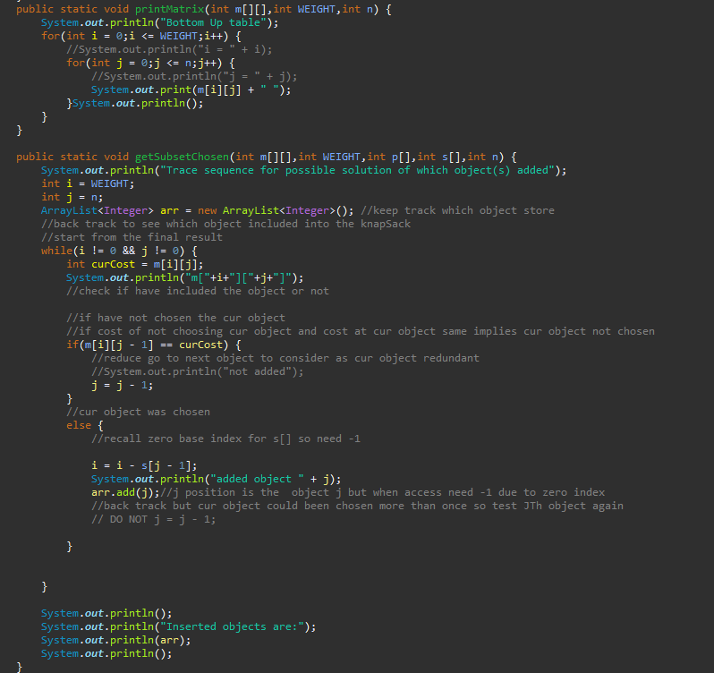
Upgrading using 2d array to get what obj inserted

Slide 13
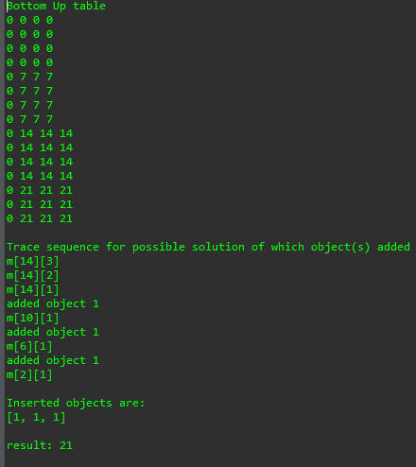
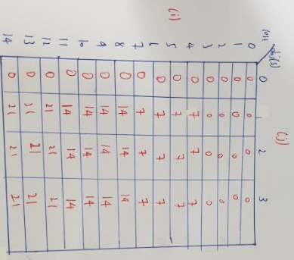
Time complexity
O(CN)

Slide 14
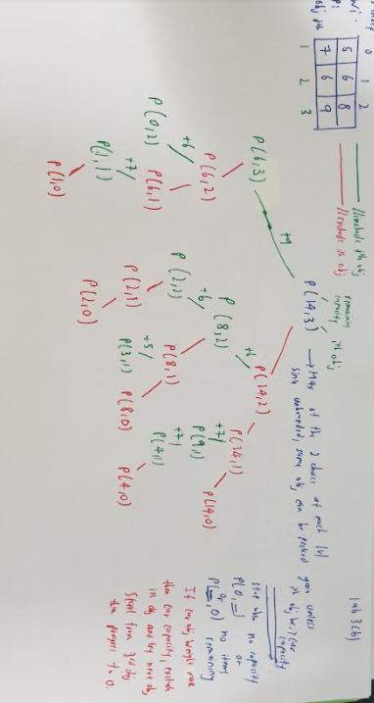
Recursive tree for part 1b

Slide 15
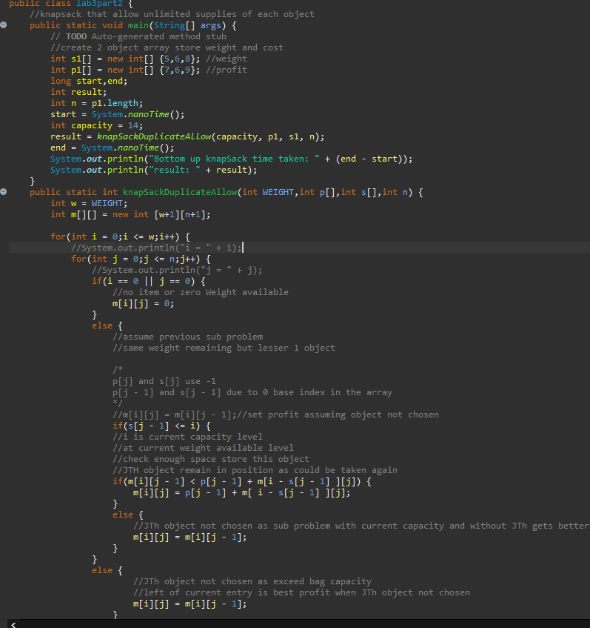
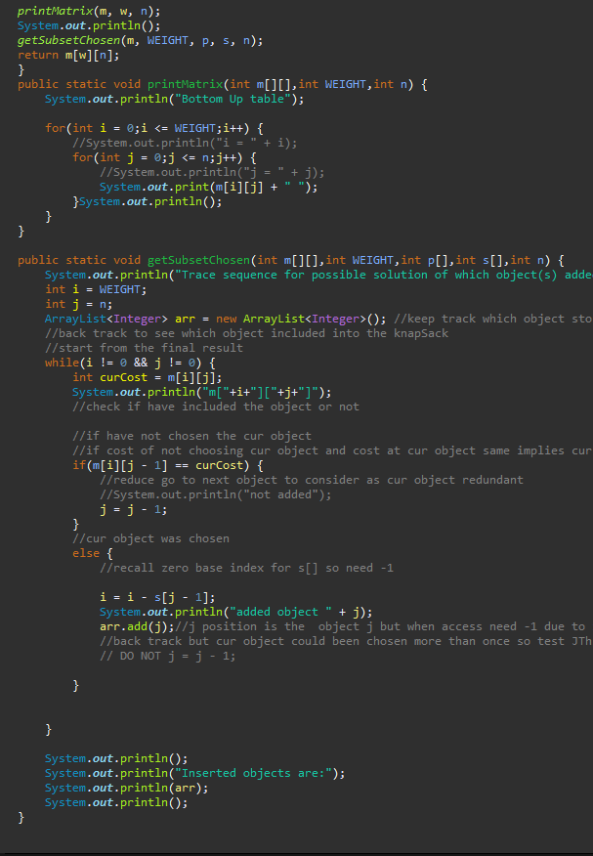

Slide 16
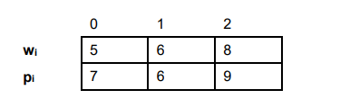
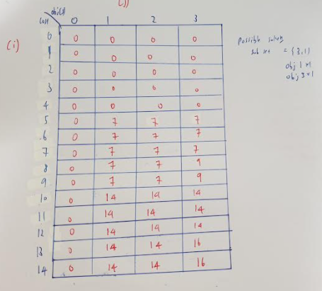
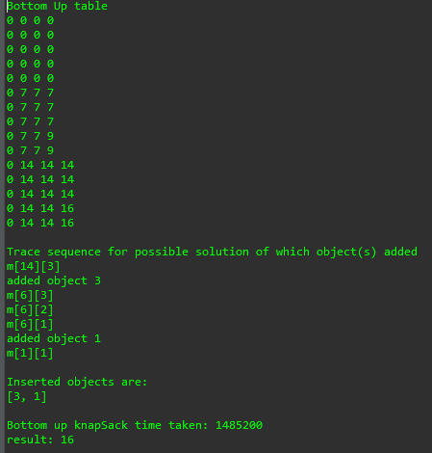
Time complexity
O(CN)

